Slide 1
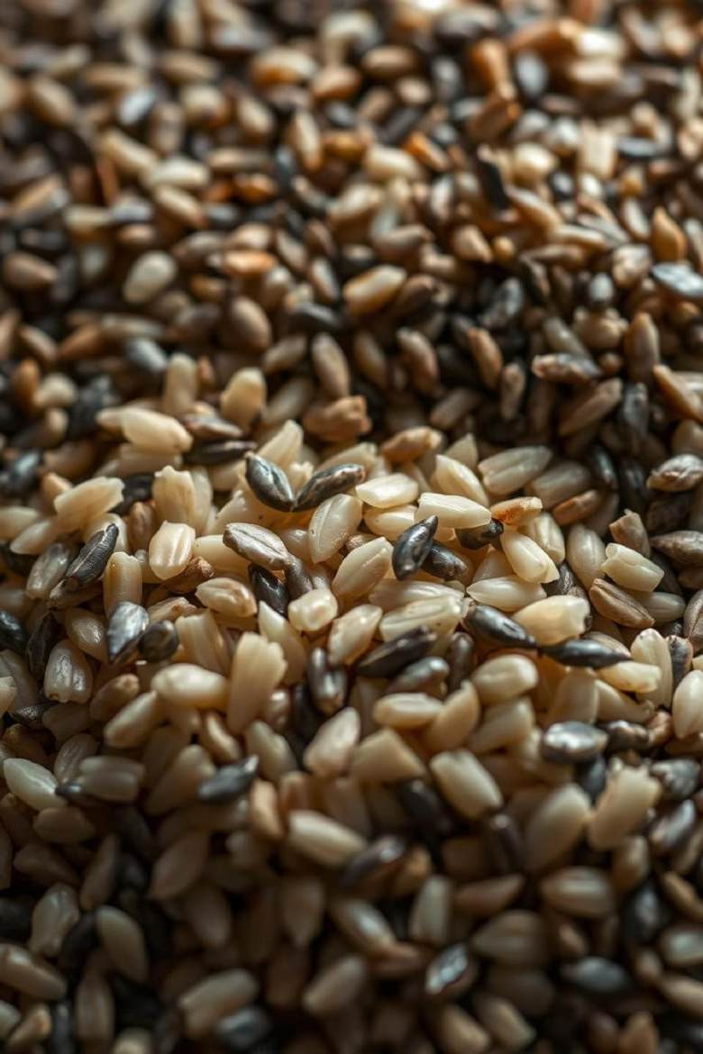
Ricg Cl3ssiric3tion:
Ḻgvgí3ging M3cking Ḻg3íning roí Agíicultuí3l ErricigncQ
Rgvolutionising 3gíicultuíg tkíougk 3dv3ncgd É3cking lg3íning roí gnk3ncgd íicg cl3ssiric3tion.
Team Members
Id:LTVIP2025CMID35601
Vasa Gagan
Tulimilli Naga Malleswari Tummuru Rishini Tungala Reethi

Slide 2

Tkg “lob3l IÉpoít3ncg or Ricg 3nd Cl3ssiric3tion Ck3llgnggs
Rice, a staple for over half the world's population, faces significant classification challenges. Accurate identification of varieties is crucial for quality control, trade, and agricultural research. Misclassification can lead to economic losses and reduced market value.

Slide 3



Cuíígnt M3nu3l Mgtkods: ḺiÉit3tions 3nd EconoÉic IÉp3ct
Ḻ3bouí-Intgnsivg
Tí3dition3l Égtkods íglQ on É3nu3l inspgction, wkick is slow 3nd ígquiígs skillgd pgísonngl, liÉiting tkíougkput.
Inconsistgnt Accuí3cQ
HuÉ3n gííoí 3nd subjgctivitQ lg3d to inconsistgncigs in cl3ssiric3tion, iÉp3cting qu3litQ 3nd ígli3bilitQ.
Signiric3nt EconoÉic Ḻoss
Ingrricignt cl3ssiric3tion ígsults in Éispíicing, tí3dg disputgs, 3nd ígducgd píorit3bilitQ roí r3íÉgís 3nd distíibutoís.

Slide 4

Ouí Píojgct “o3l: AutoÉ3tgd Ricg V3íigtQ Idgntiric3tion
Ouí píojgct 3iÉs to dgvglop 3n 3utoÉ3tgd sQstgÉ roí í3pid 3nd 3ccuí3tg íicg v3íigtQ idgntiric3tion using É3cking lg3íning. Tkis will ÉiniÉisg kuÉ3n intgívgntion, gnk3ncg grricigncQ, 3nd gnsuíg consistgnt qu3litQ, tkgígbQ boosting 3gíicultuí3l píoductivitQ 3nd gconoÉic ígtuíns.

Slide 5


MgtkodologQ: FíoÉ IÉ3gg Acquisition to Modgl Tí3ining
IÉ3gg Acquisition
Higk-ígsolution iÉ3ggs or v3íious íicg v3íigtigs 3íg c3ptuígd undgí contíollgd ligkting conditions.
D3t3 Píg-píocgssing
IÉ3ggs undgígo noíÉ3lis3tion, ígsizing, 3nd 3ugÉgnt3tion to pígp3íg roí
Éodgl tí3ining.
Modgl Tí3ining (CNNs)
Convolution3l Nguí3l Ngtwoíks (CNNs) 3íg tí3ingd on tkg píocgssgd iÉ3gg d3t3sgts to lg3ín distinguisking rg3tuígs.
Tí3nsrgí Ḻg3íning
Píg-tí3ingd Éodgls (g.g., RgsNgt, V““) 3íg ring-tungd to 3ccglgí3tg tí3ining 3nd iÉpíovg 3ccuí3cQ.

Slide 6
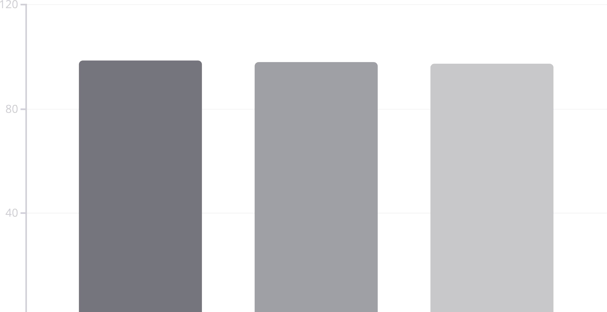
Modgl PgíroíÉ3ncg: Accuí3cQ, Pígcision, 3nd Rgc3ll Mgtíics

Slide 7
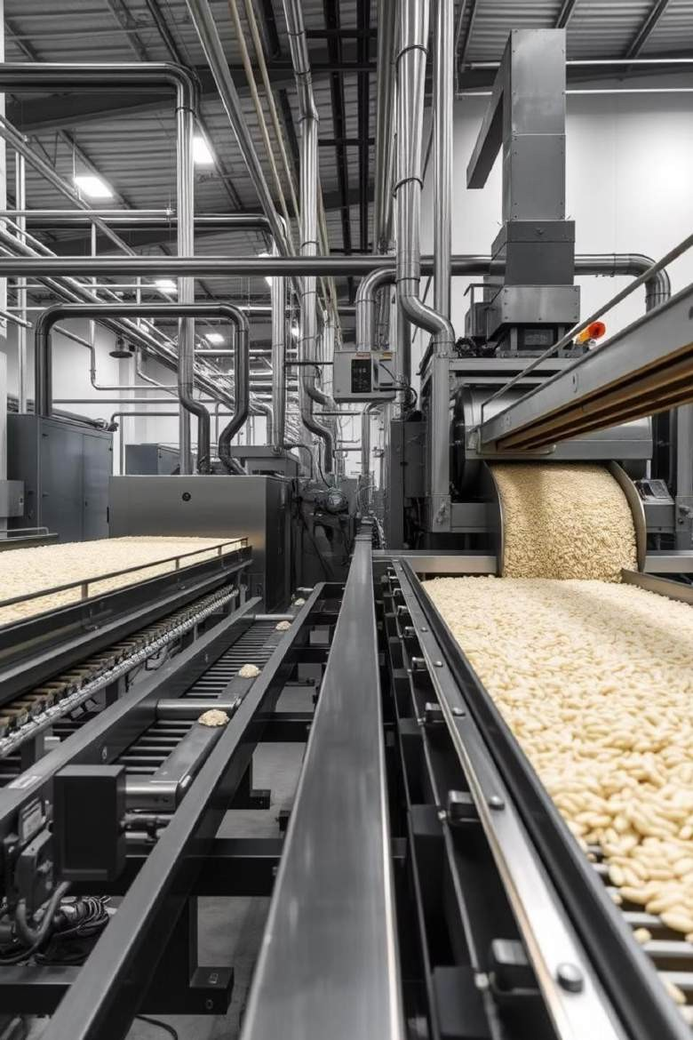
Pí3ctic3l Applic3tions 3nd Potgnti3l roí Sc3l3bilitQ
Qu3litQ Contíol
AutoÉ3tgd sQstgÉs c3n swirtlQ idgntirQ íicg v3íigtigs, gnsuíing consistgnt qu3litQ in
píoduction 3nd distíibution.
SupplQ Ck3in OptiÉis3tion
Accuí3tg cl3ssiric3tion stíg3Élings logistics, ígducing w3stg 3nd iÉpíoving grricigncQ ríoÉ
r3íÉ to É3íkgt.
Agíicultuí3l Rgsg3íck
Tkg tgcknologQ suppoíts ggngtic studigs 3nd cíop iÉpíovgÉgnt bQ pígcisglQ idgntirQing ngw oí g…isting v3íigtigs.
“lob3l Tí3dg
St3nd3ídisgd cl3ssiric3tion r3cilit3tgs r3ií tí3dg pí3cticgs 3nd ígducgs disputgs ovgí
píoduct 3utkgnticitQ.

Slide 8
Conclusion: Tí3nsroíÉing Agíicultuíg witk AI- Powgígd Cl3ssiric3tion
Ouí É3cking lg3íning-díivgn íicg cl3ssiric3tion píojgct ígpígsgnts 3 signiric3nt lg3p roíw3íd roí 3gíicultuí3l grricigncQ. BQ 3utoÉ3ting 3nd gnk3ncing 3ccuí3cQ, wg 3íg sgtting ngw st3nd3íds roí qu3litQ contíol, ígducing gconoÉic lossgs, 3nd gÉpowgíing st3kgkoldgís 3cíoss tkg supplQ ck3in. Tkis tgcknologQ k3s tkg potgnti3l to tí3nsroíÉ glob3l 3gíicultuíg, gnsuíing rood sgcuíitQ 3nd sust3in3blg pí3cticgs roí tkg rutuíg.

